Slide 1


NVMe Over Fabrics Senior Design Project June 3, 2016
ERIC LITVINSKY
JAYDEN NAVARRO
ALICE YU
TEAM MEMBERS:
JOHN GEMIGNANI
COY HUMPHREY
Notes:
Coy

Slide 2
Problem Statement
Data Center
Compute Nodes (Servers)
Storage Array
Storage Area Network (SAN)
SCSI Drive
Internet
SCSI Drive
SCSI Drive
SCSI Drive
SCSI Drive
Current Data Center Technology
Notes:
Coy

Slide 3
Problem Statement
Data Center
Compute Nodes (Servers)
Storage Array
NVMe over Fabrics Protocol
NVMe Drive
Internet
NVMe Drive
NVMe Drive
NVMe Drive
NVMe Drive
Goal: Benchmark and assess viability of nbdX (Pre-Spec NVMe over Fabrics)
Notes:
Coy

Slide 4
Project Goals
Assemble protocol stack
Fix stability issues
Build benchmarking suite
Gather and analyze benchmarking results
Notes:
Alice

Slide 5
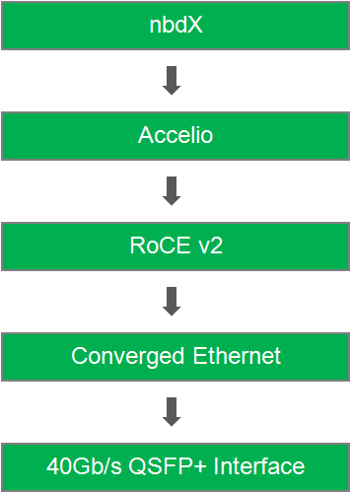
Protocol Stack
■ Network block device over Accelio framework
■ Presented as a regular storage block device on the local system
■ Pre-specification version of NVMe over Fabrics
■ Library for high-performance asynchronous IO using RDMA
■ Provides Zero-copy data delivery
■ Designed for multi-core CPUs and multi-threaded applications
■ Remote Direct Memory Access (RDMA) is capable of allowing server to server data movement management with minimal CPU involvement
■ Provides a lossless connection on top of the Ethernet protocol by implementing the Data center bridging enhancements (DCB) to the Ethernet standard.
■ Bridges, converges, and controls the flow of multiple classes of traffic over an Ethernet network
■ Hardware support for RDMA
■ Interconnect system for the I/O ports that supports 40Gb/s Ethernet
■ Mellanox OFED driver
Notes:
John
Remember to mention that nbdX is a pre-specification version of NVMe over Fabrics.
RoCE is the transport and the network layer
Converged Ethernet = link layer
Cards = physical layer
“40G QSFP+ Interface” instead of “Infiniband QSFP+ Interface”
For the new presentation:
nbdX on 1 slide with the other technologies on another (What is nbdX? Why nbdX?)
HPE presentation
Focus on nbdX and Accelio, since everyone on Sam’s team will alrady know what the other stuff is

Slide 6
What is nbdX?
nbdX
Network block device over Accelio
Pre-specification release of NVMe Over Fabrics
Built to utilize high speed network fabrics through Accelio
Presents remote storage as locally attached storage
Benefits
Maximized performance for remote attached NVMe storage
Minimized CPU utilization of the host system
Notes:
John

Slide 7
What is Accelio?
Accelio
Open source, high-performance, acceleration library for fabrics
Built to fully utilize high speed network fabrics and the protocols they support
Provides
Designed for multi-core CPUs and multi-threaded applications
Supports multiple network transport layers
Benefits
High throughput and low CPU utilization
Notes:
John

Slide 8
Run_All Script
Benchmarking Suite
Python automated framework
Python scripts for benchmarking tools
‘Run_All’ Bash script with error report handling
Results parsed and outputted to CSV format
I/O Benchmark
Network Benchmark
Error Log
Custom Framework
Reports/Graphs
Git
Results

Slide 9
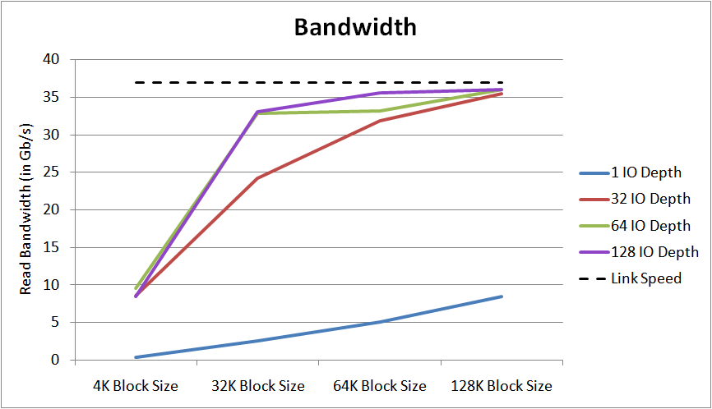
Graph 1: On large block sizes, nbdX performed close to our maximum measured link speed (37 Gb/s)
9

Slide 10
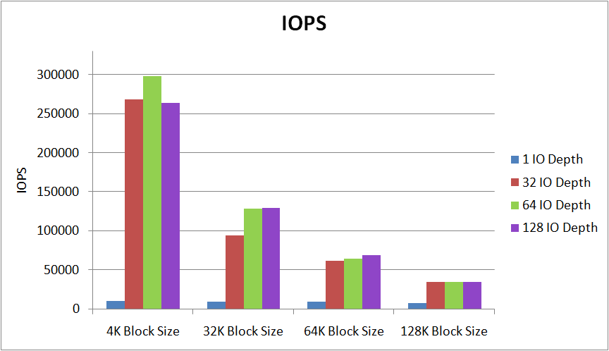
Graph 2: nbdX was able to yield >250,000 4K Read IOPS on 32, 64, and 128 IO depths.
10

Slide 11
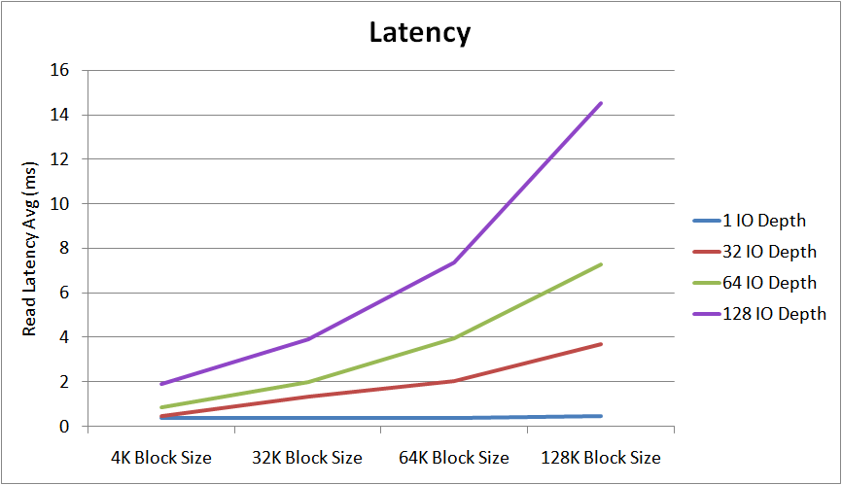
Graph 3: For the tested block sizes and IO depths, nbdX performed within the expected latency range.
11

Slide 12
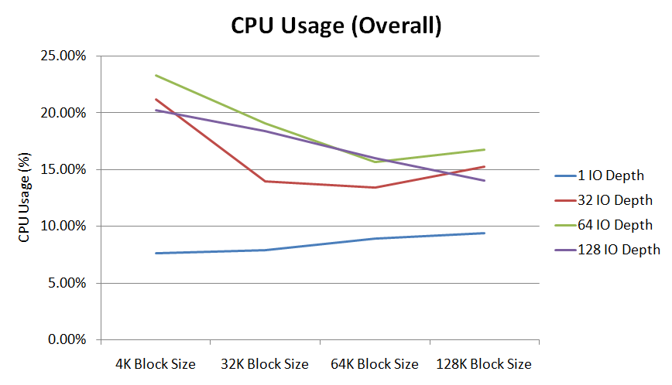
Graph 4: Overall CPU utilization for the tested block sizes and IO depths
12

Slide 13
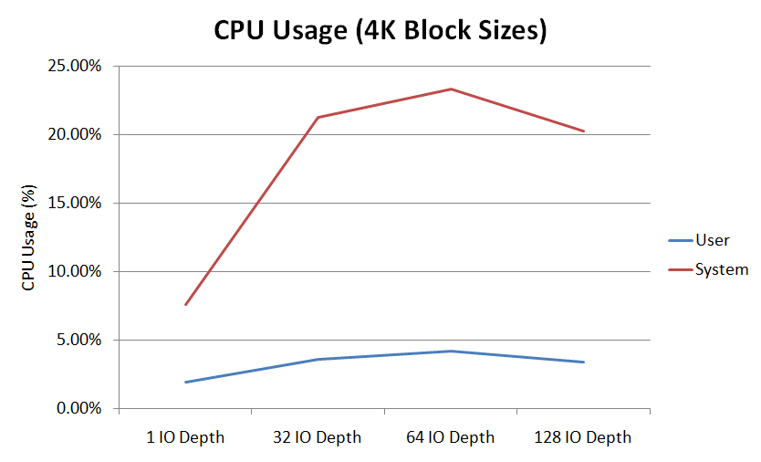
Graph 5: System (kernel) and user usage for 4K blocks versus IO Depth

Slide 14
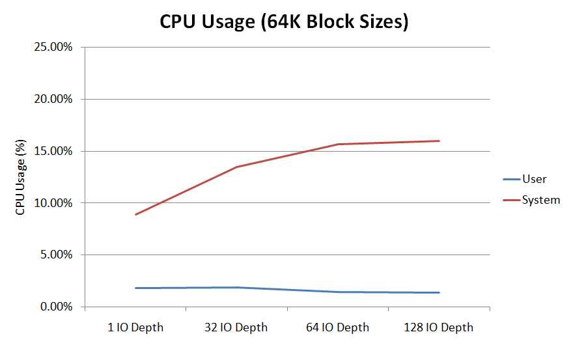
Graph 6: System (kernel) and user usage for 64K blocks versus IO Depth
14

Slide 15
Summary
Local NVMe Attached Storage Compared to nbdX Remote Ramdisk
 | NVMe Locally Attached Drives | nbdX (NVMe over Fabrics) Ramdisk
Bandwidth | ~8.0 Gb/s | ~36 Gb/s
IOPS | ~100,000 4K IOPS | >250,000 4K IOPS
▪ Bandwidth reached near maximum link speed
▪ Latency within expected range of NVMe over Fabrics spec
▪ IOPS exceed current NVMe attached drive capabilities

Slide 16
Conclusion
NVMe over Fabrics is a viable solution for network attached storage arrays with NVMe drives

Slide 17
Thanks to
Samuel Fineberg, Ph.D., Distinguished Technologist, Storage Chief Technologist Office at Hewlett Packard Enterprise
Dr. Linda Werner, Ph.D., Faculty Advisor, UCSC
Daniel Fava, Graduate Teaching Assistant, UCSC
Kevin Cheng for participating in the first half of the project
Hewlett Packard Enterprise for the hardware and support provided

